Slide 1
Database Management System (DBMS)
Unit ⇒ 1
Presented by By Milan Bista Sir

Slide 2
1.1 Introduction
Data, Information, Database and DBMS

Slide 3
Data
Data is the raw fact which is composed of alphabets, digits, special symbols, etc.
Example: Ram, 26, Mahendranagar, etc.

Slide 4
Information
The processed data that gives meaningful result is called information.
It is an organised collection of related data which gives a complete sense.
Example: Ram is 26 years old who lives in Mahendranagar.

Slide 5
Database
It is a collection of interrelated data of objects or entities in a structured/tabular form.
Example: customer record, books library, etc.

Slide 6
What is DBMS?
DBMS is a software that defines, manipulates and manages the database. It allows access, update and retrieval of data as requested.
Examples: MS Access, Oracle, MySQL, etc.

Slide 7
Some Basic Terms in DBMS
i) Field: Property/attribute of table. E.g., name, phone number.
ii) Record/tuple: Collection of interrelated fields.
E.g., 1, Ram.
iii) Table: Arrangement of rows and columns.
iv) Object: Used in database to store and manipulate data.

Slide 8
v) Primary key: Primary key is a unique key/value in database which is used to show the relationship between different tables or objects and also helps in reducing data duplicacy. For example, registration number, citizenship number, etc.
vi) Alternate key: Alternate key is not a primary key, but combining one or more columns can make it unique. It can also be used instead of primary key.
vii) Candidate key: Sometimes there is more than one attribute processing the unique identification property. In this case all attribute combination provide a unique record which is called candidate key.
viii) Foreign Key: A foreign key is a column or set of columns in a table that refers to the primary key of another table. It establishes a relationship between two tables and enforces referential integrity.

Slide 9
Relational Table Example (Keys)
Candidate key 1 Candidate key 2 Candidate key 3
Primary key alternate key1 alternate key2
Reg. No | Name | contact | Email
101 | Rameshowr | 9800000001 | ram@mail.com
102 | Shyam | 9800000002 | shyam@mail.com
Reg. No | Phone | Email
101 | 9800000001 | ram@mail.com
102 | 9800000002 | shyam@mail.com
Reg. No | Phone | Email
101 | 9800000001 | ram@mail.com
102 | 9800000002 | shyam@mail.com

Slide 10
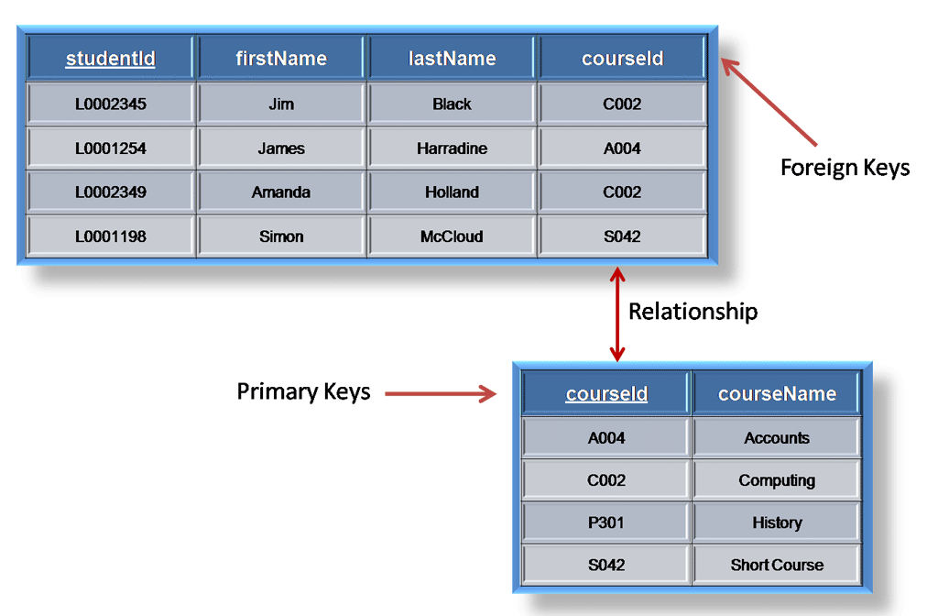

Slide 11

1.3 Advantages of DBMS
Reduce Redundancy→ It stores everything in one place, so you don’t have duplicate copies lying around.
Easy Sharing → Lets people quickly access and work on files together.
Combines Data Sources → It pulls info from different places into one view for better insights.
Auto Backup & Restore → Regularly saves your data and recovers it if anything gets lost.
Strong Security → Uses passwords and locks to keep private info safe from hackers.
Works Anywhere → Accessible on phones, computers, or other devices—anytime, anywhere.

Slide 12


Disadvantages of DBMS
Expensive→ Buying equipment and software is expensive.
Gets old fast → Tech changes quickly, so systems become outdated.
Training needed → Staff must keep learning new skills.
Hacking risks → Hackers can steal private data.
Hard to connect → Doesn’t work smoothly with older systems.
Can’t handle growth → Struggles when more users or data arrive.

Slide 13
DDL and DML Overview
i)DDL: (Data Defination Language)Defines structure of table (CREATE, DROP, RENAME,ALTER)
Example DDL: CREATE TABLE Stu (S_id INT(4), S_name CHAR(64));
ii)DML(Data Manipulation Language) Manipulation of records (INSERT, DELETE, SELECT, UPDATE)
Example DML: INSERT INTO Stu (id,name)VALUES (1, 'Ram');

Slide 14



Differences between DDL and DML
Feature | DDL(Data Defination Language) | DML(Data Manipulation Language)
Definition | It is a type of SQL command that helps to define database schemes. | It is a type of SQL command that helps to retrieve and manage data in relational databases.
Execution | Used during the design or restructuring of a database schema. | Used during daily operations to handle data within tables.
Examples | CREATE, DROP, ALTER are some DDL commands. | INSERT, UPDATE, DELETE are some DML commands.
Effect | Commands affect the entire database or the table. | Commands affect one or more records in a table.
Rollback | SQL statements cannot be rolled back. | SQL statements can be rolled back.

Slide 15




1.5 Database Model
There are different forms of database management systems, they are:
1) Hierarchical Model:
It is one of the oldest types of database models in which all records are arranged in a tree-like structure. In this model, the records are in a parent-child relationship basis in which children have only one parent, but parents can have many children. Also, the top-level record gets higher priority than the child at the bottom level.

Slide 16
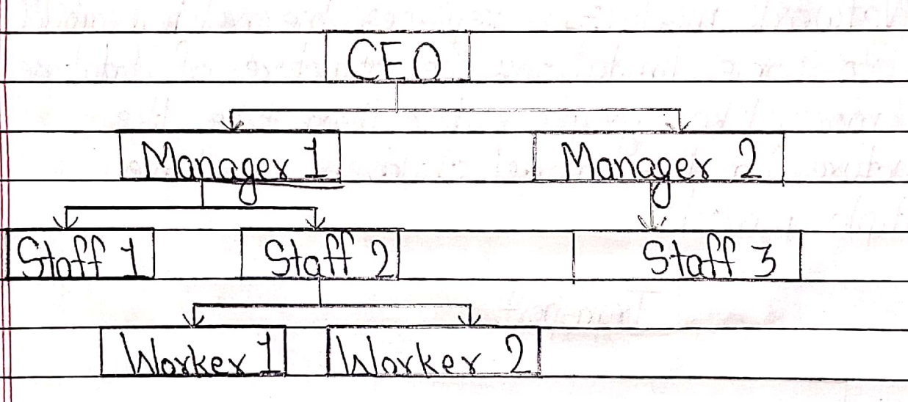
For example:

Slide 17
Advantages of Hierarchical Model:
The advantages of the hierarchical model are mentioned below:
It is easiest model to implement.
It supports one-to-one and one-to-many relationships.
It is Highly secure model.
Searching is easy if the parent is known.

Slide 18
Disadvantages of Hierarchical Model
The disadvantages of the hierarchical model are as follows:
It is old-fashioned and outdated.
It does not support many-to-one relationships.
It increases data duplicacy (redundancy).
Its dependency is only on the single parent node.
If the parent node is disturbed, then the whole hierarchical model may be disturbed.

Slide 19
Uses or Application Areas of Hierarchical Database Model
IBM IMS (Information Management System): Widely used in banking, insurance, and airline reservation systems (e.g., IBM’s SABRE for flight bookings).
Healthcare: Early hospital record systems stored patient data hierarchically (e.g., insurance claims linked to patient records).
Operating Systems: File directories (e.g., Windows Registry, UNIX/Linux file systems) use hierarchies to organize files and folders.
Network Management: Models network topologies (e.g., parent nodes as central servers, children as connected devices).

Slide 20
2 )Network model: It replaces hierarchical model due to some limitations. The structure of database is more like graph rather than tree-like structure. In this model, children can have multiple parents.

Slide 21
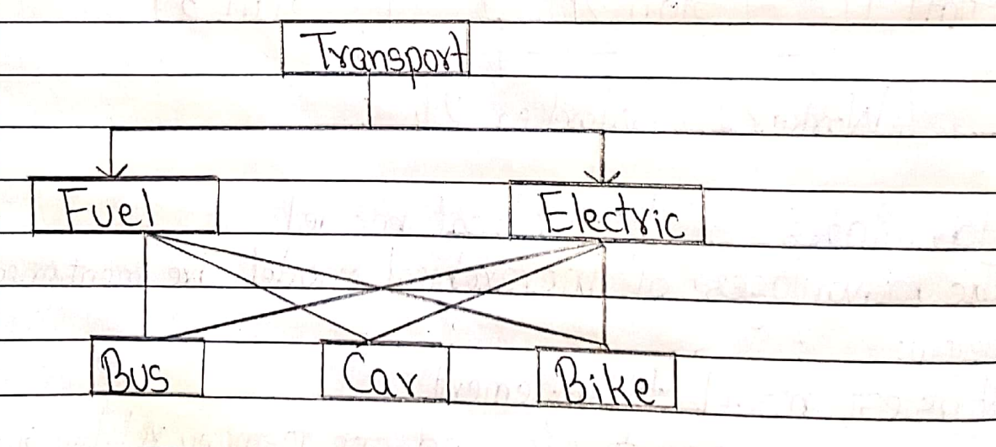
For example:

Slide 22
Advantages of Network Model
The advantages of the network model are mentioned below:
It supports many-to-one relationships.
In this model searching is faster.
It is Simple and easy to design.
It reduces data duplicacy.
It is good for dynamic database.

Slide 23
Disadvantages of network model The disadvantages of network model are mentioned below: i) It is less secure. ii) Difficult for complex relationship.
iii) Rigid Structure: Changing the database layout requires reprogramming.
iv) Complex to Design and Maintain: Initial setup is complicated and ongoing changes are difficult.

Slide 24
Uses or Application Areas of Network Database Model
Industrial Systems:
Manufacturing workflows (e.g., tracking parts shared across multiple assemblies).
Supply chain networks with interconnected suppliers and distributors.
Knowledge Graphs: Organizing semantic data (e.g., early AI systems).
Transportation Routing: Mapping roads/junctions (e.g., flight paths with shared hubs).

Slide 25
3) Relational database model: The database model which stores and displays data in tabular form (ie rows and columns) is known as relational database model. For example, My SQL, Oracle, Ms-Access etc.

Slide 26
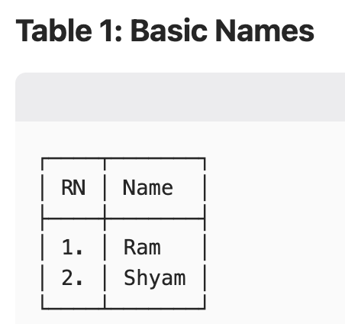
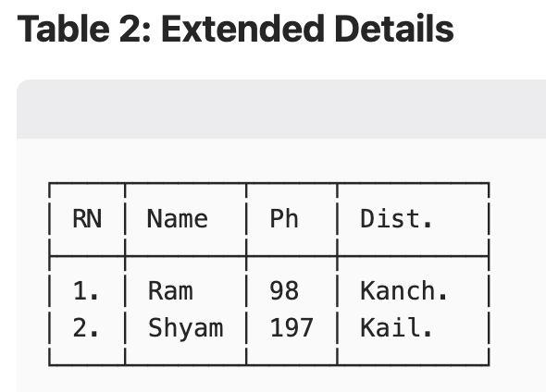
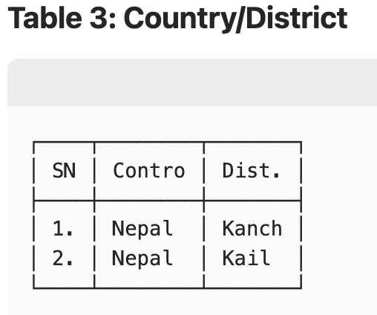
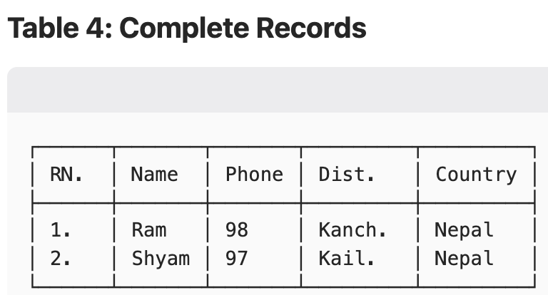

Slide 27
Advantages of relational database model The advantages of relational database model are as follows:
Database processing is faster.
It has low chances of data duplicacy.
Data integrity can be easily implemented.
It is Highly secured.

Slide 28



Disadvantages of Relational Database Model
It is More complex than other models.
It may be difficult to understand.
Role overload: Sometimes too many roles may be created because of complex relationships.
Can be slow for big data → When the database grows very large, operations may take longer to complete.

Slide 29
Uses or Application Areas of Relational Database Model
1. Enterprise Systems
Business Operations:
ERP (SAP, Oracle): Manages finance, HR, supply chain.
CRM (Salesforce): Tracks customer interactions and sales pipelines.
E-commerce: Product catalogs, order processing (e.g., Shopify, Amazon backend).
2. Financial Services
Banking: Transaction records, account management (e.g., core banking systems).
Stock Markets: Trade settlements, portfolio tracking.
3. Healthcare
Electronic Health Records (EHR): Patient histories, prescriptions (e.g., Epic, Cerner).
Medical Research: Clinical trial data storage and analysis.
4. Web & Mobile Applications
User Data: Profiles, authentication (e.g., MySQL for social media platforms).
Content Management: WordPress, Drupal for dynamic websites.
5. Government & Education
Public Records: Tax databases, census data.
Learning Management Systems (LMS): Student enrollments, grades (e.g., Moodle).
6. Logistics & Supply Chain
Inventory Management: Real-time stock levels, supplier tracking (e.g., Walmart’s systems).
Shipping: Route optimization, package tracking (FedEx, UPS).

Slide 30

ER Model (Entity-Relationship Model) or ER-Diagram
Shows relationships between real-life entities and their attributes.
Components of ER Diagram
Entity
Represents real-life objects(nodes) (e.g., student, library, hospital).
Symbol: Rectangular shape.
Attributes
Characteristics of an entity (e.g., single-valued, multi-valued, derived).
Symbol: Oval shape. -> single valued

Slide 31
-> multi valued
-> derived valued

Slide 32
3)Relation
Shows logical coordination between two or more entities.
Symbol: Diamond shape
4)Lines (Connectors)
Link entities, attributes, and relations.
Symbol: Single straight line

Slide 33
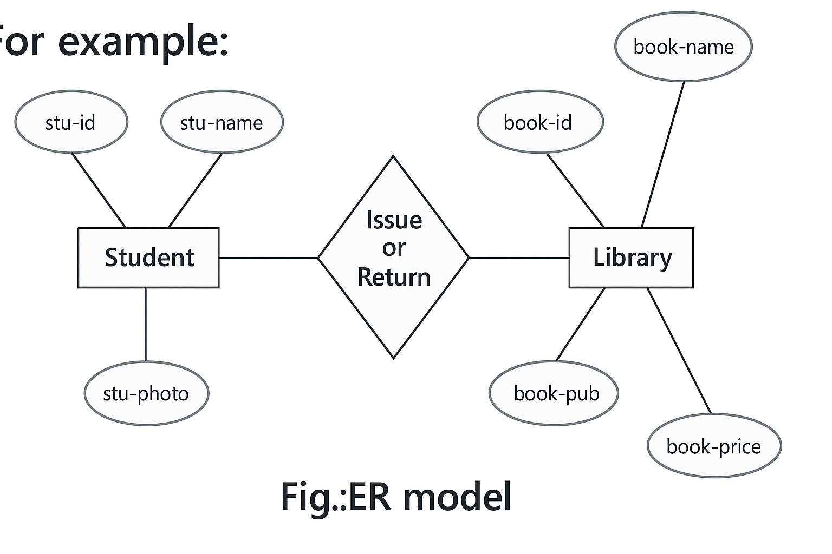
DOB
age
Phone-no

Slide 34
Advantages of ER Model
The advantages of ER model are mentioned below: i) Easy to represent and understand the flow of data as it is in pictorial form. ii) Helps in creating a link between several entities. iii) Easy to implement ER-diagram into DBMS.
iv) "Facilitates effective communication between technical and non-technical teams."

Slide 35
The disadvantages of ER-model are mentioned below:
i)It may become complex with more no. of relations. ii) Users need to remember symbols.
iii) It cannot easily represent recursive relationships.
iv) It lacks support for defining operations or methods.

Slide 36
1.6 Centralized vs Distributed Database
Centralized Database
Definition: It is a simple type of database which works on client-server basis. In this type, the database is centralized and runs on a single computer system.
Fig: Centralized Database System
DB
A
Server
B
C

Slide 37
Advantages of centralized database The advantages of centralized database are as follows: i) It is suitable for smaller organization. ii) It has high security. iii) Maintenance of database is easier.
iv) It Ensures strong data consistency.

Slide 38
Disadvantages of centralized database The disadvantages of centralized database are as follows: i) It is dependent on central server. If the server goes down, the whole system will be disturbed.
ii) One breach exposes all data – like stealing the whole cabinet, not just a folder.”
iii) Not suitable for large organization. iv) Not suitable for huge data traffic.

Slide 39
Distributed database:
It is a complex type of database system which is a collection of multiple logically interrelated databases which may be in different geographical locations. In other words, it is a collection of different centralized databases in different locations.

Slide 40
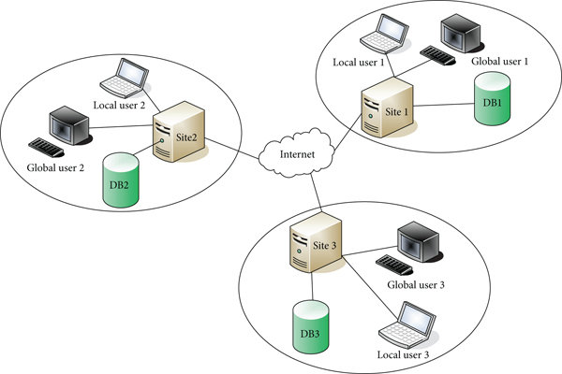
Fig: Distributed Database system

Slide 41
Advantages of distributed database i) It can handle huge data traffic at the same time. ii) Backup and recovery is easier. iii) It is suitable for large organization.
iv) Faster for global users → Stores data near where it's used, so someone in Tokyo doesn’t need to wait for data from New York.

Slide 42
Disadvantages of Distributed Database
It is highly expensive.
It is highly complex.
It may have several security issues.
Maintenance is difficult.

Slide 43
Differences Between Centralized and Distributed Database
Centralized Database | Distributed Database
1) It depends upon a central server. | 1) It has several servers.
Cannot handle huge traffic simultaneously. | 2) Can handle huge traffic simultaneously
3) Maintenance is easier. | 3) Maintenance is difficult.
4) More secure. | 4) Less secure.
5) Not suitable for large organizations. | 5) Suitable for large organizations.

Slide 44



1.7 Concept of Normalization
Definition: Normalization is a process in which a complex database table is broken down into separate tables. This makes the data model more flexible and easier to maintain, reducing the complexity of the database.

Slide 45
Types of Normalization
a) 1NF (First Normal Form)
Rules:
The data field must be atomic (single record).
It Eliminates duplicate rows and columns in the same table.
It Minimizes data redundancy in the database table.

Slide 46
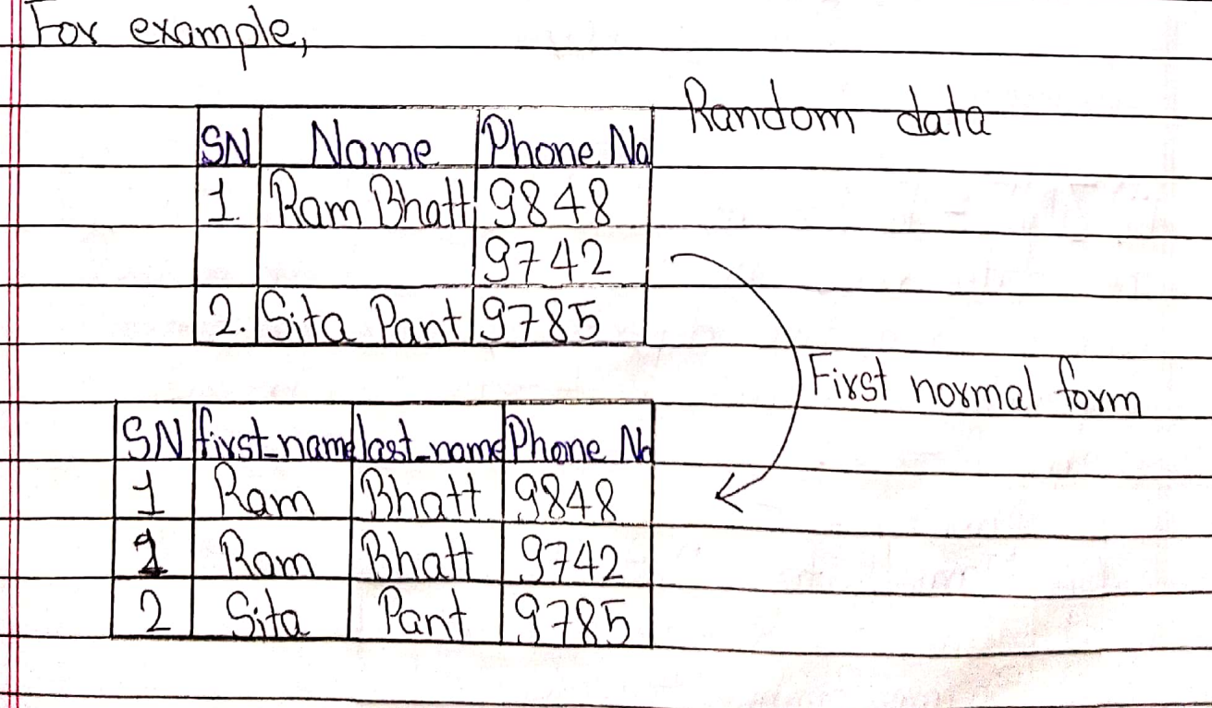

Slide 47
2NF (Second Normal Form)
2NF builds upon the First Normal Form (1NF) by further addressing the removal of duplicate data.
Rules to qualify as 2NF:
A table must already satisfy all 1NF requirements.
It enforces data dependency rules i.e All non-key attributes must be functionally dependent on the entire primary key (or key attributes), not just part of it.

Slide 48
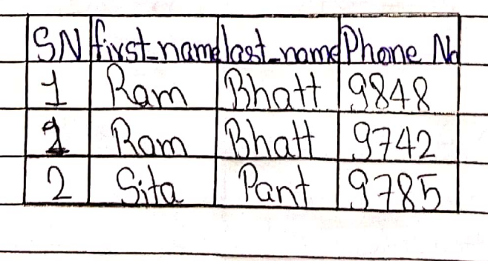
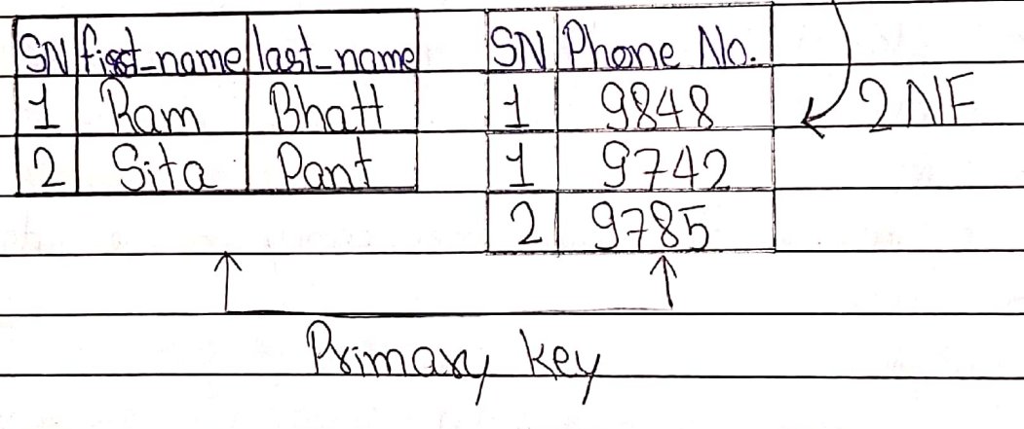


Slide 49
3NF (Third Normal Form)
Rules to satisfy 3NF:
The data must already be in Second Normal Form (2NF).
It must eliminate transitive dependencies. Here transitive dependency means, if A->B and B->C, then A->C.
[Notes: 3NF requires removing such indirect dependencies by splitting tables appropriately.]

Slide 50
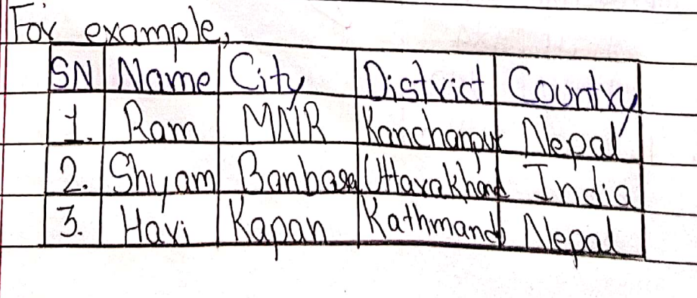
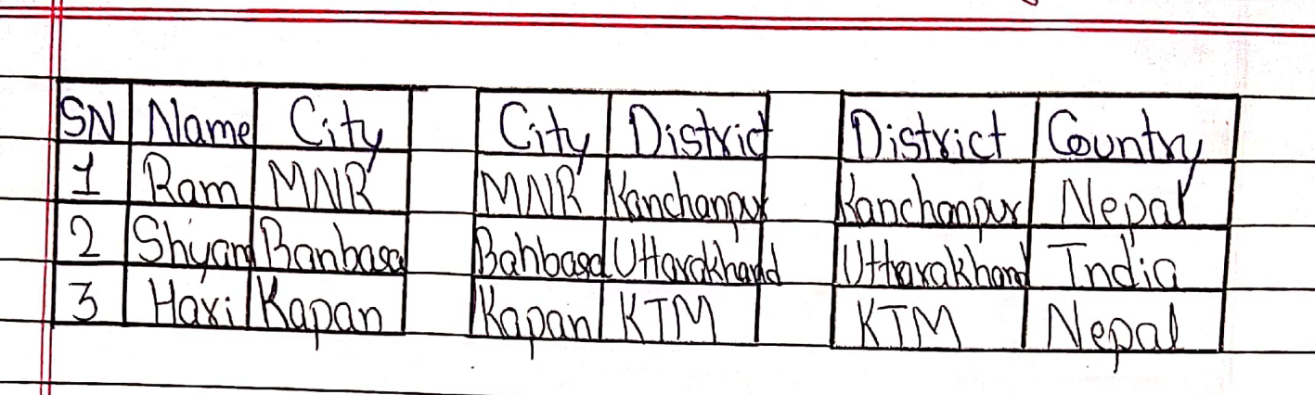




Slide 51
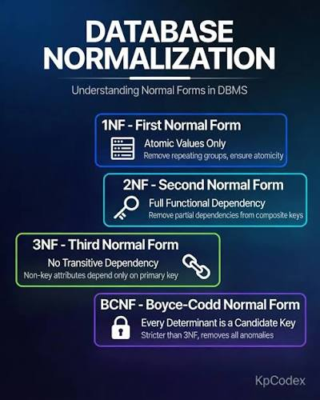
conclusion

Slide 52
1.8 Data Security
Definition: Data security means protection of hardware/software data essential for DBMS.
Hardware Security:
Regular maintenance: Check and fix hardware parts often to avoid sudden breakdowns.
Control temperature: Use cooling systems to stop overheating, which can damage hardware.
Keep dust out: Use filters and covers to prevent dust from causing overheating or short circuits.
Stable power: Use surge protectors and UPS to guard against power surges that can break hardware or lose data.

Slide 53
2) Software security:
Use genuine software:
Only use software that's official and paid for (or from trusted sources). Why? Because fake or cracked software might have hidden viruses or security holes that aren't fixed.
Use strong anti-virus and update it regularly:
Install good anti-virus to catch and remove viruses, and keep it updated so it knows about new threats.
Use a strong firewall:
A firewall is like a security guard for your internet connection it blocks hackers and bad programs from getting in or out without permission.
Use proper authentication techniques:
Add extra steps to log in, like your fingerprint, a code sent to your phone (OTP), or a PIN. This makes it much harder for someone else to get into your accounts.
Use a VPN if necessary:
When you're on public Wi-Fi (like at a cafe or airport), use a VPN to scramble your internet activity so snoopers can't see what you’re doing.

Slide 54
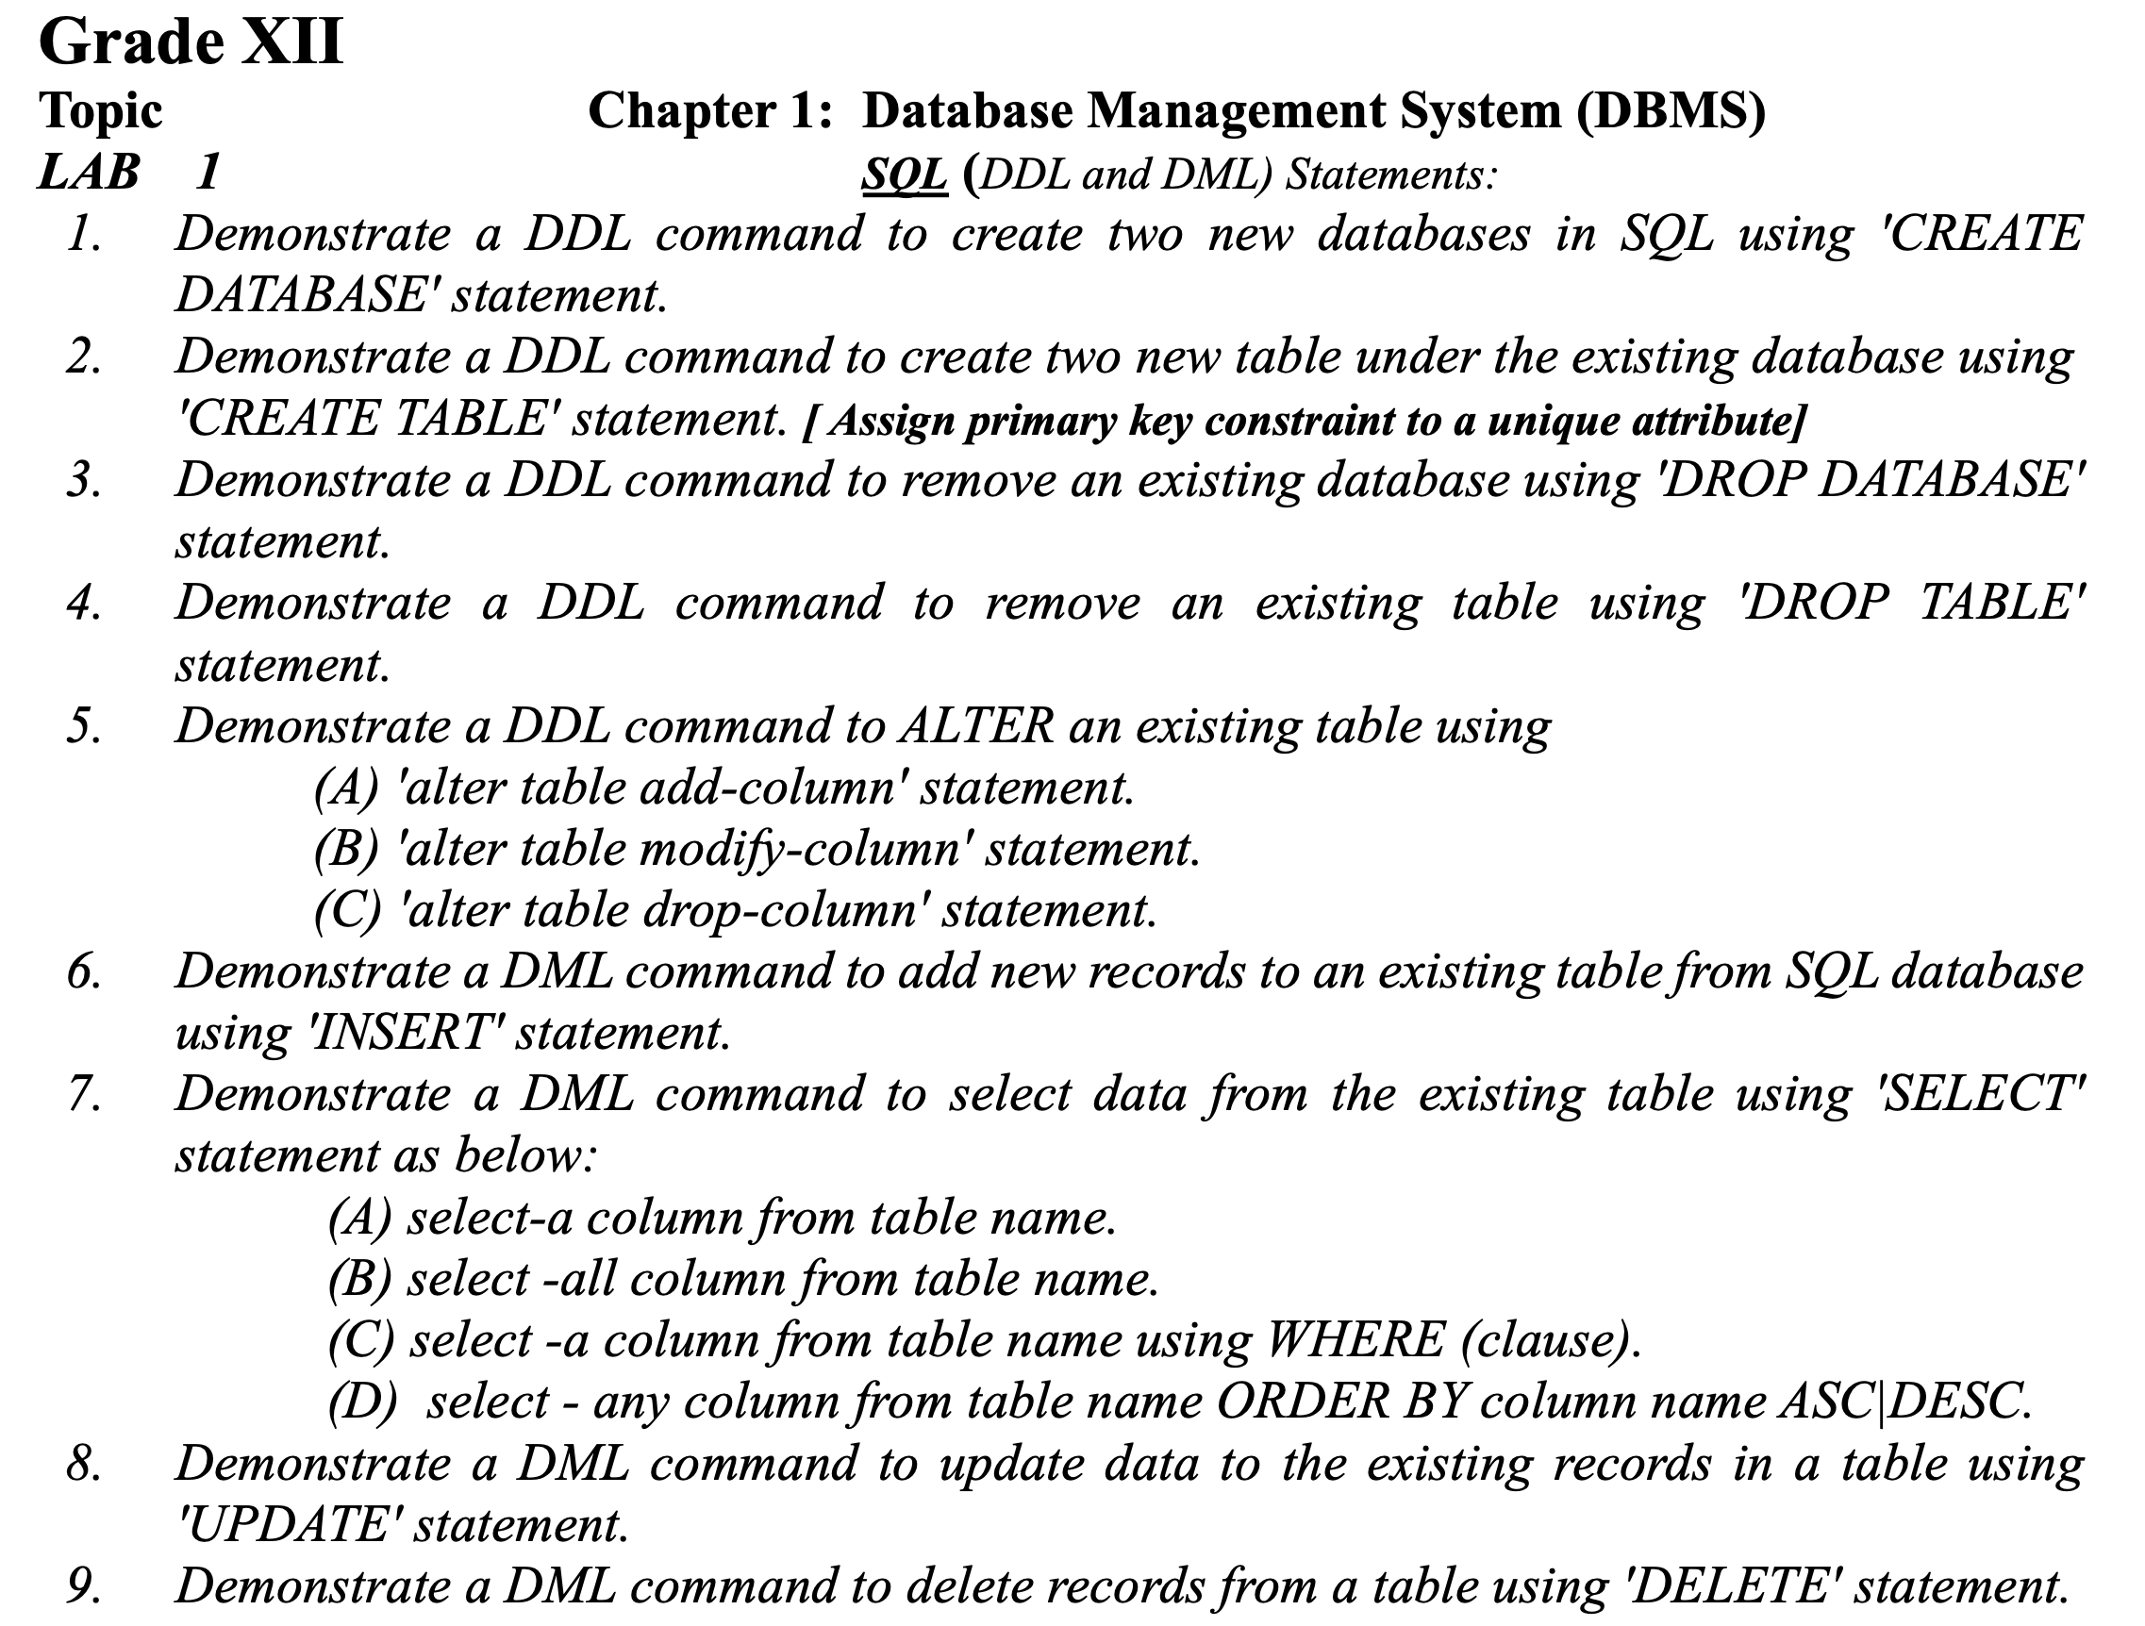
LAB WORKS

Slide 55
Data Defination Language (DDL) COMMANDS
create create database statement
create table statement
drop drop database statement
drop table statement
alter alter table add-column statement.
alter table modify-column statement
alter table drop-column statement

Slide 56
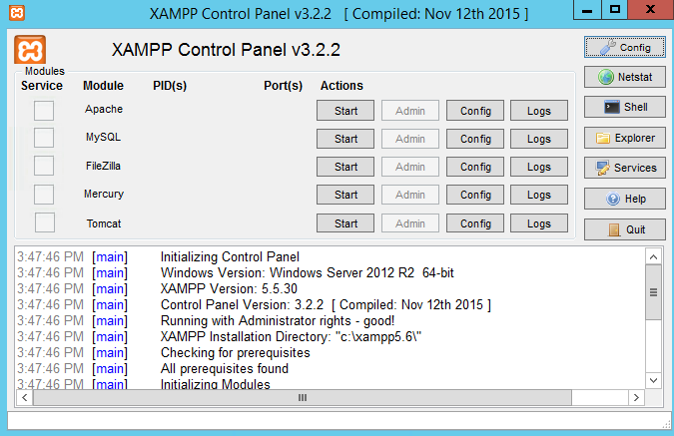


XAMPP →Cross-Platform, Apache, MariaDB, PHP, and Perl
Click here

Slide 57
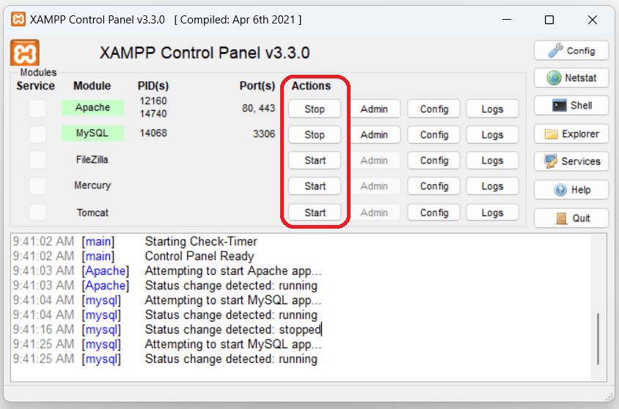

Click here

Slide 58
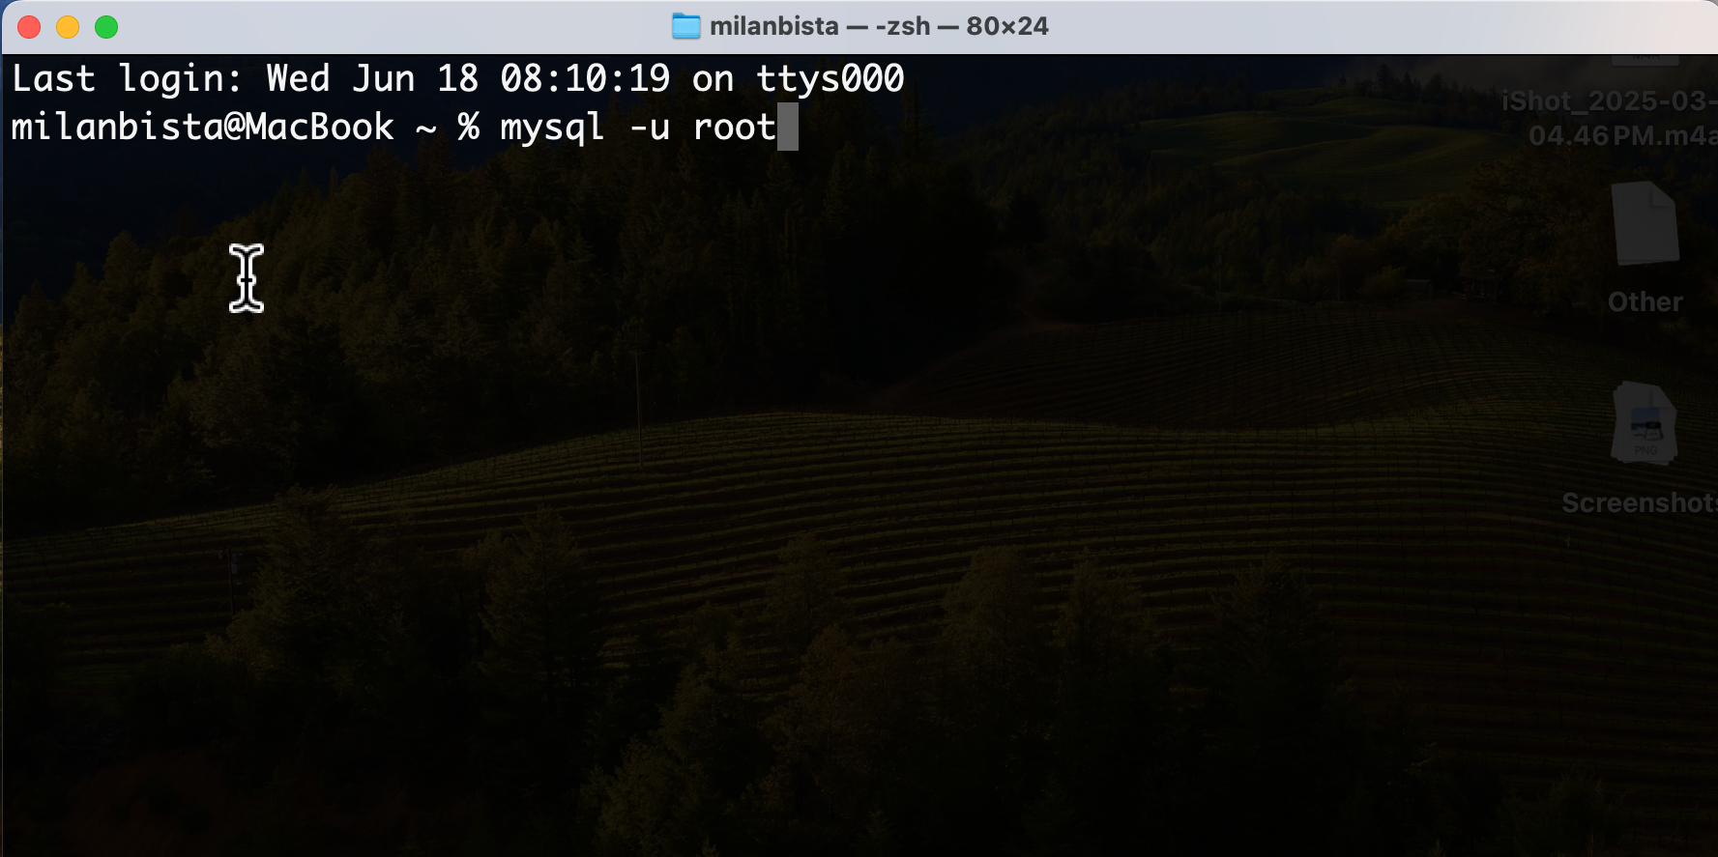
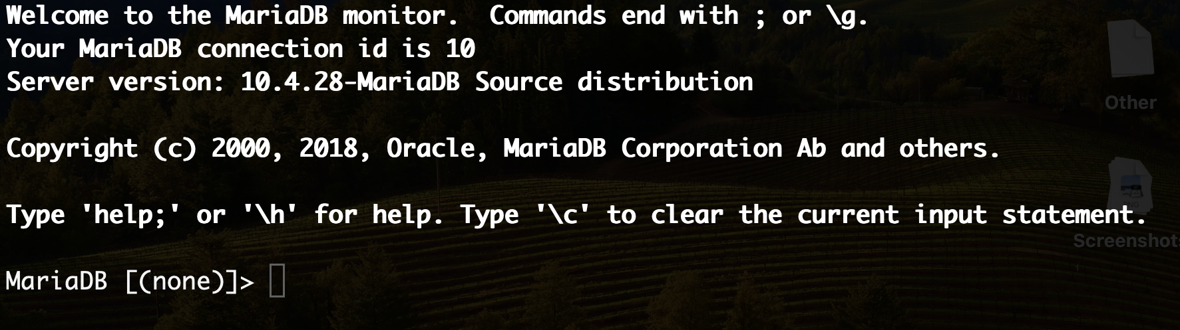


Slide 59
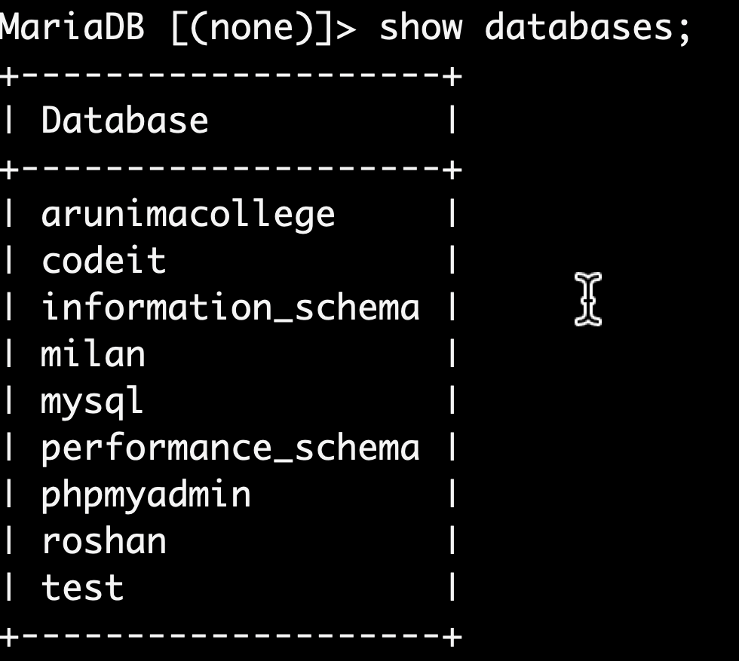
1.Demonstrate a DDL command to create two new databases in SQL using 'CREATE DATABASE' statement.
Query:
create database milan;
create database roshan;
show databases;
Output:

Slide 60
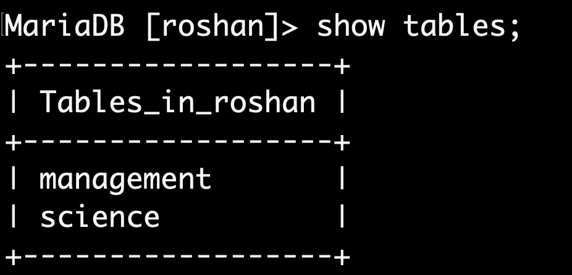



2.Demonstrate a DDL command to create two new table under the existing database using 'CREATE TABLE' statement. [ Assign primary key constraint to a unique attribute]
Query:
use roshan;
create table science(roll int primary key, name varchar(25), grade int);
create table management(roll int primary key, name varchar(25), address varchar(25));
show tables;

Slide 61
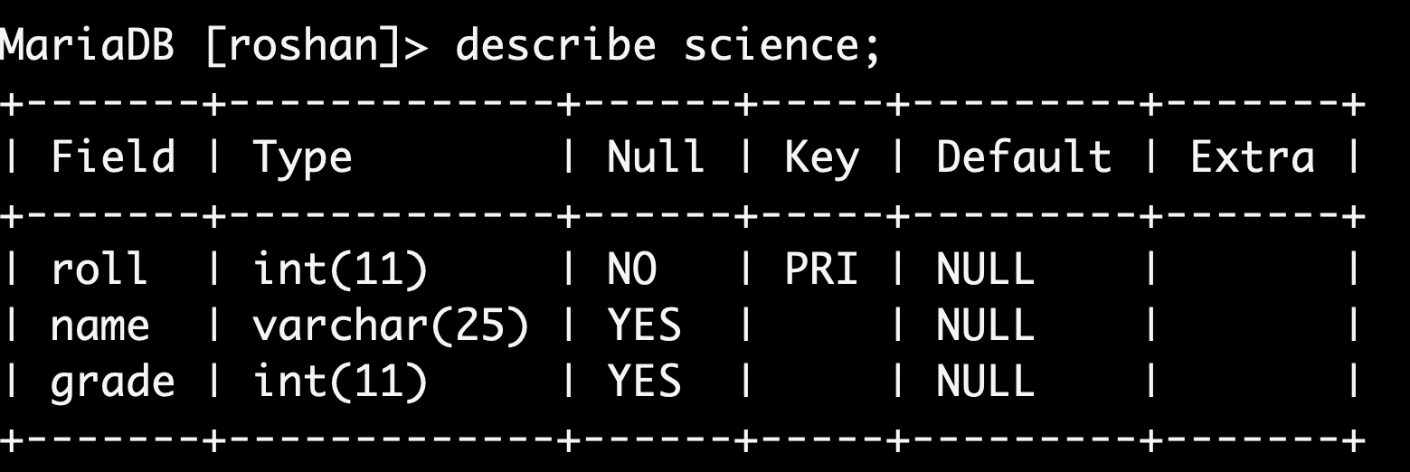
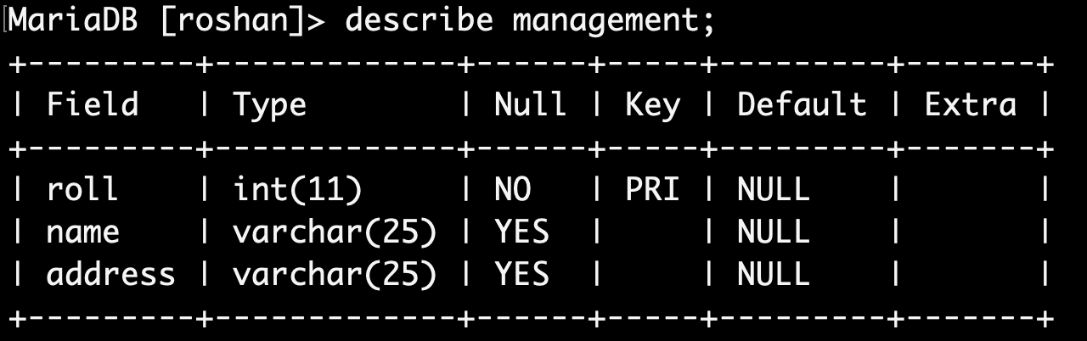
describe science;
describe management;

Slide 62
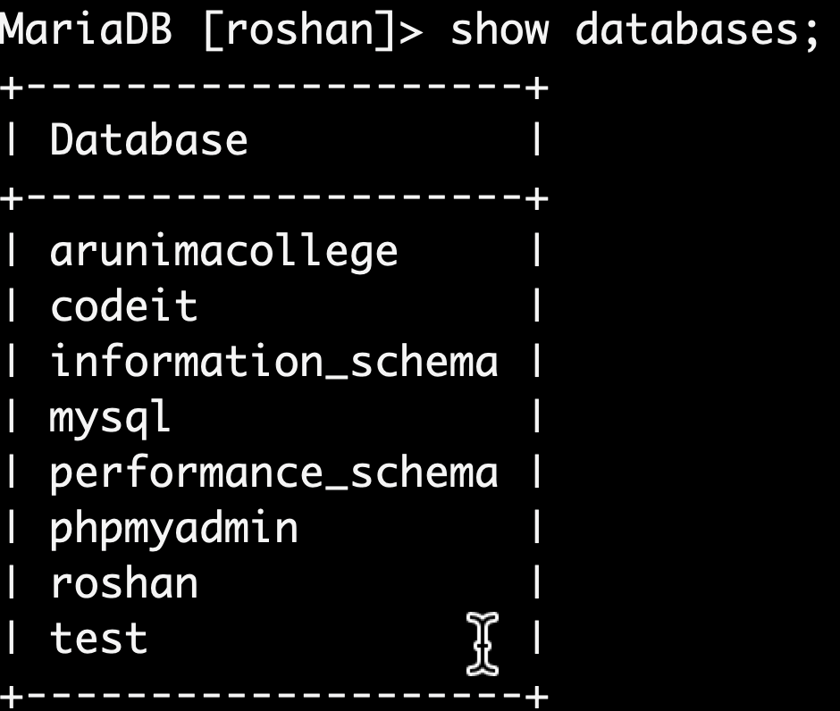
3) Demonstrate a DDL command to remove an existing database using 'DROP DATABASE' statement.
Query:
drop database milan;
show databases;

Slide 63
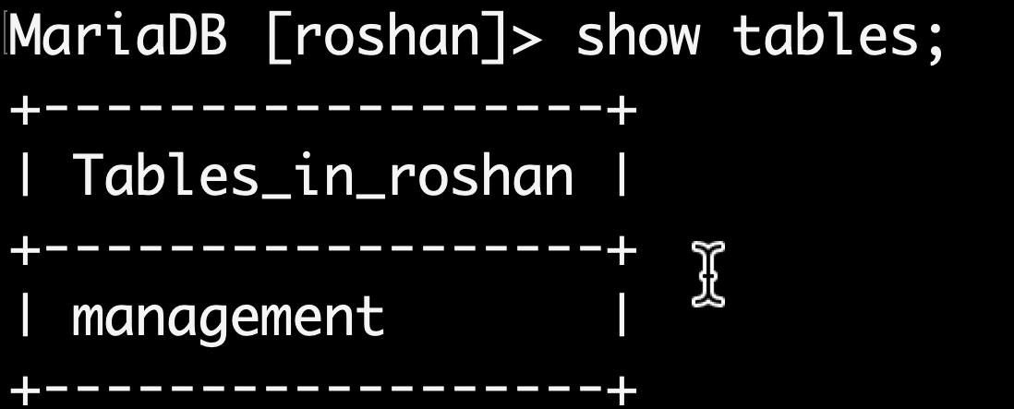
4) Demonstrate a DDL command to remove an existing table using 'DROP TABLE' statement.
Query:
1. drop table science;
show tables;

Slide 64
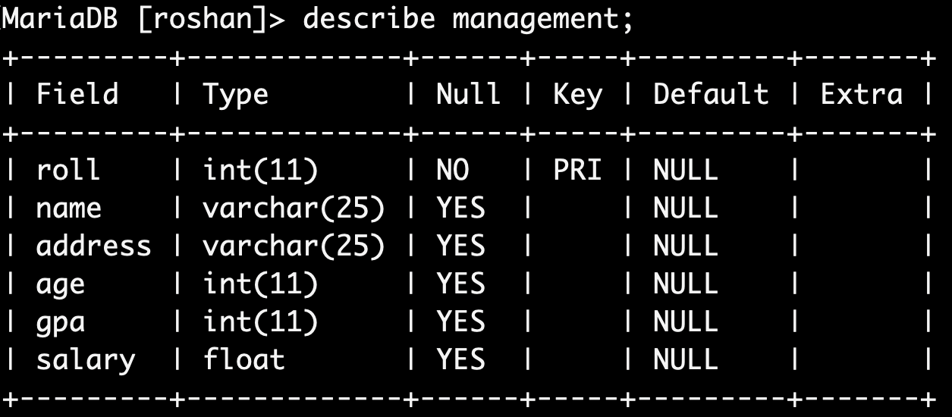


(A)Demonstrate a DDL command to ALTER an existing table using a 'alter table add-column' statement.
Query:
alter table management add age int, add gpa int, add salary float;
describe management;

Slide 65
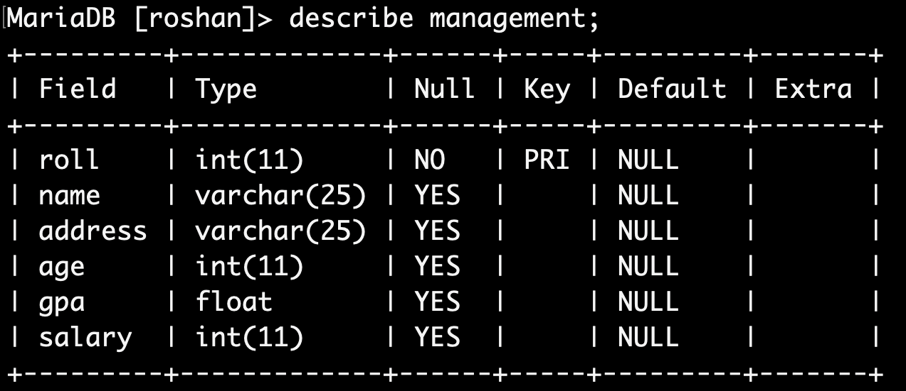

(B)Demonstrate a DDL command to ALTER an existing table using a 'alter table modify-column' statement.
Query:
alter table management modify salary int, modify gpa float;
describe management;

Slide 66
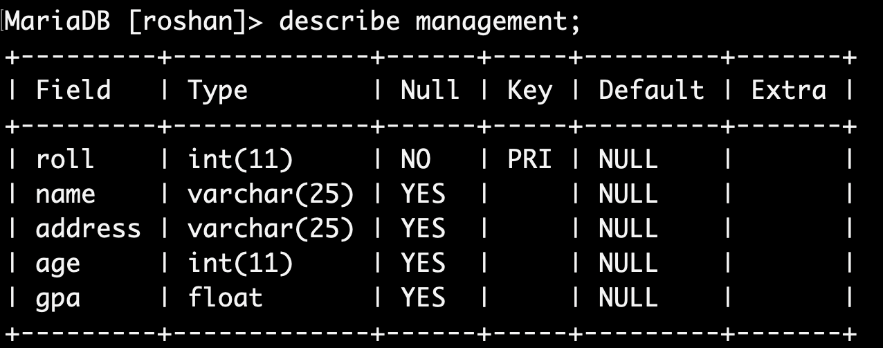

(C)Demonstrate a DDL command to ALTER an existing table using a 'alter table drop-column' statement.
Query:
alter table management drop salary;
describe management;

Slide 67
Data Manipulationa Language (DML) COMMANDS
insert insert into table_name
select select-all column_name from table_name (use *)
select –a single column_name from table_name. select -a column_name from table_name using WHERE (clause)
select - any column_name from table_name ORDER BY column_name ASC|DESC.
update update table_name set column_name WHERE clause
4. delete delete from table table_name WHERE column(condition)

Slide 68
6) Demonstrate a DML command to add/insert new records to an existing table from SQL database using 'INSERT' statement.
Query:
(1)
insert into management values(1,'Akash','Kathmandu', 14,3.2),(2,'Bikash','bHaktapur',15,3.6),(3,'Prakash','Lalitpur',16,4.0);

Slide 69
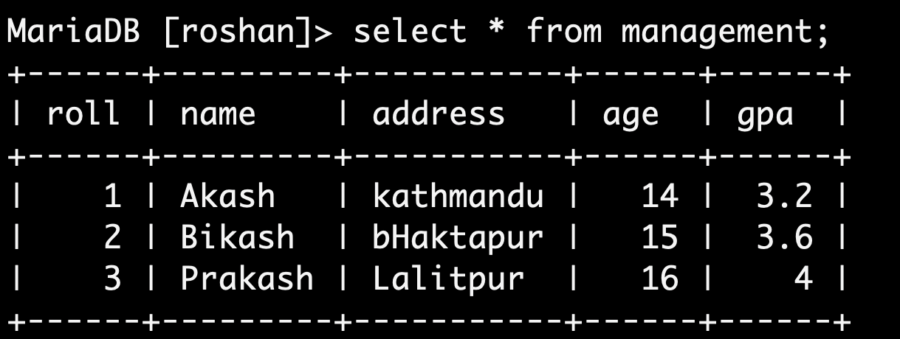

7) (A) ​​Demonstrate a DML command to select all records from each column from the existing table using ‘SELECT *’ .
Query:
select * from management;

Slide 70
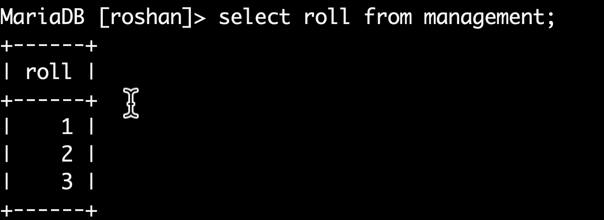



7) (B) ​​ ​​Demonstrate a DML command to select all records from any single column from the existing table using 'SELECT’.
Query
select roll from management;

Slide 71
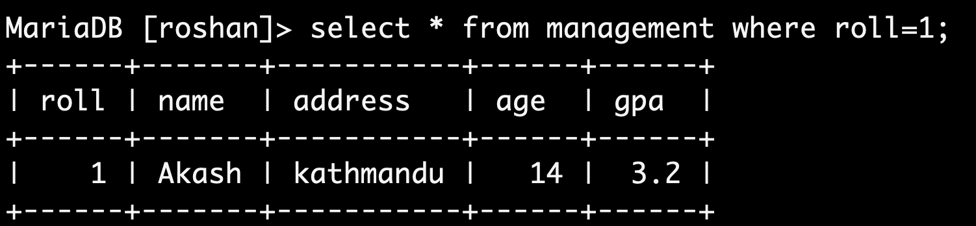

7) (C) ​​ ​​Demonstrate a DML command to select single record from all column from the existing table using 'SELECT *’ and ‘WHERE’ clause.
Query
select * from management where roll=1;

Slide 72
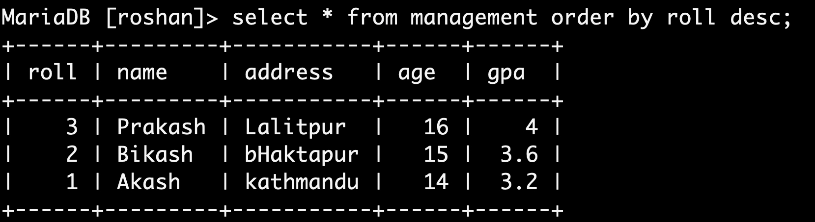




7) (D) ​​ ​​Demonstrate a DML command to select any column from table_name ORDER BY column_name ‘ASC|DESC’.
Query
select * from management order by roll desc;

Slide 73
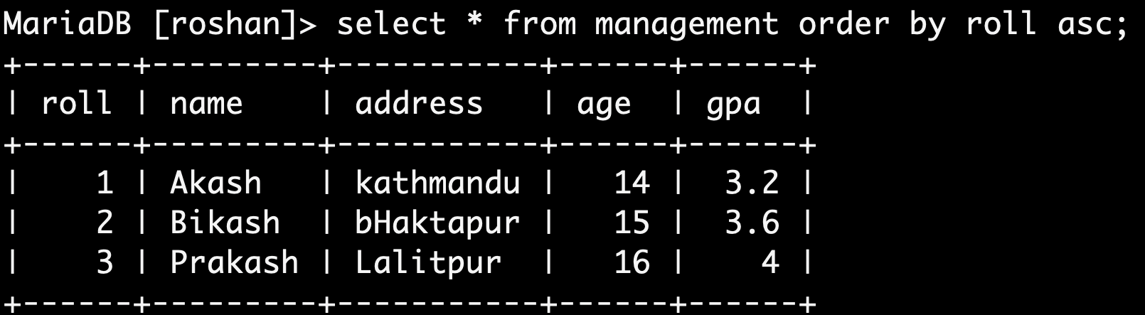



Query
2) select * from management order by roll asc;

Slide 74
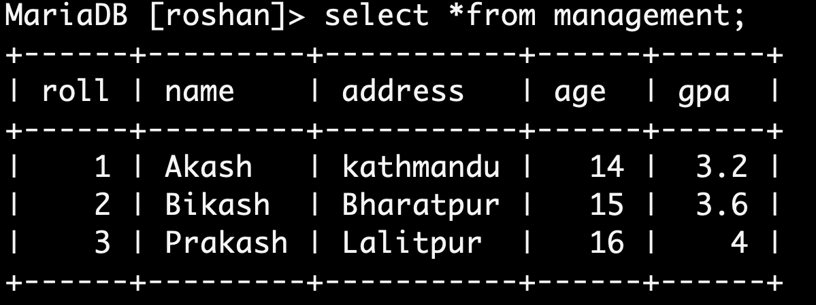





8) Demonstrate a DML command to update data to the existing records in a table using 'UPDATE' statement.
Query
3)update management set address= 'Bharatpur' where roll=2;
select * from management;

Slide 75
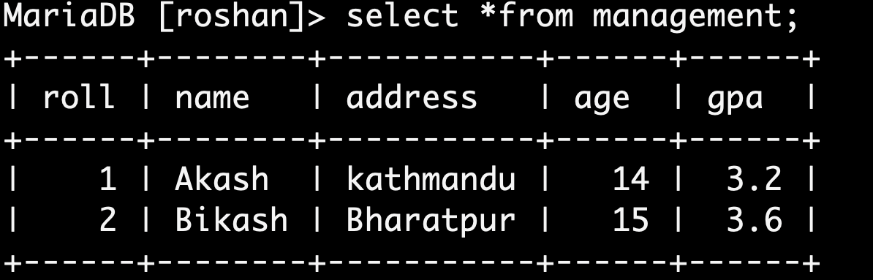




9) Demonstrate a DML command to delete any records from a table using 'DELETE' statement.
Query:
delete from management where gpa>3.6;
select *from management;

Slide 76
THE END

